Slide 1


The relationship between the music I listen to and the weather
Ege Derman
32246

Slide 2


Music Listening Habits and Weather

Slide 3
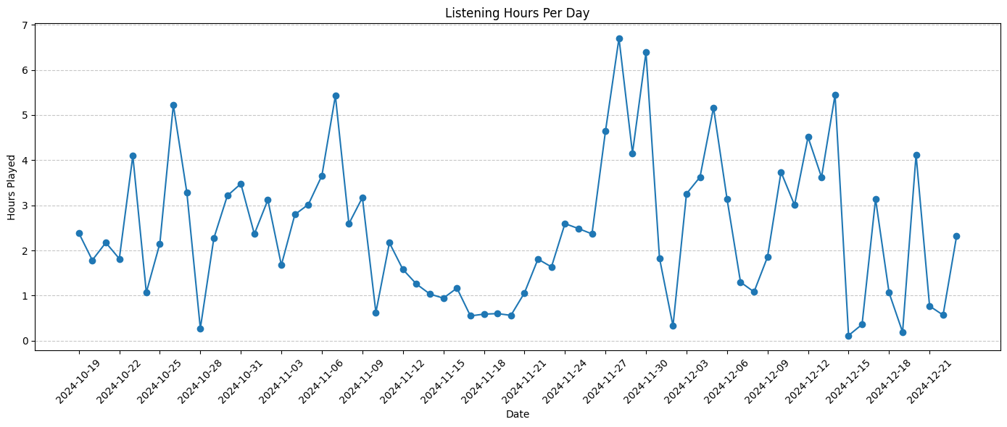
Here is the listening hours per day. It seems like a random distribution.

Slide 4
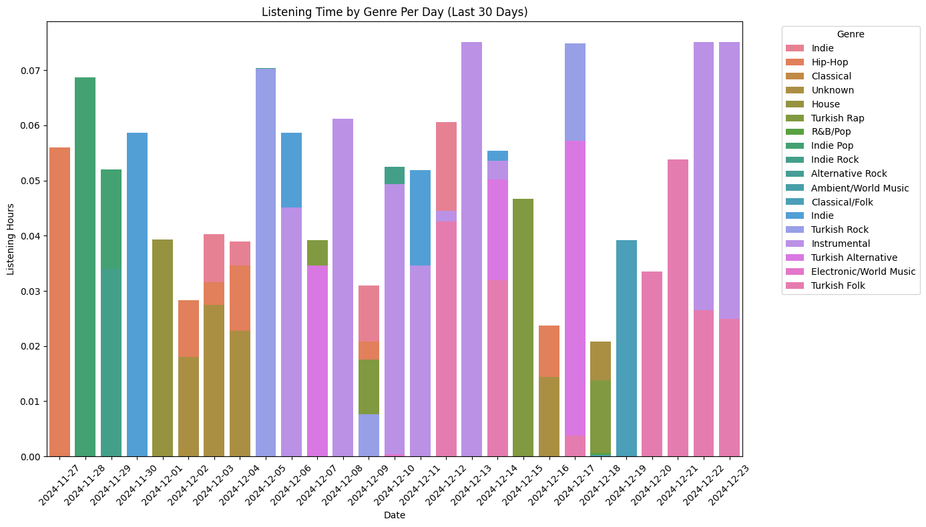
The graph shows which genre listened most at that day. In the Spotify dataset there was not a column as genre, so i manually assigned their genres to the top 50 artist I listen most. As shown in the graph, generally Instrumental genre overweights other genres.

Slide 5
My hypothesis is that as the weather gets cold and rainy I prefer slower songs, skip songs more easily.

Slide 6
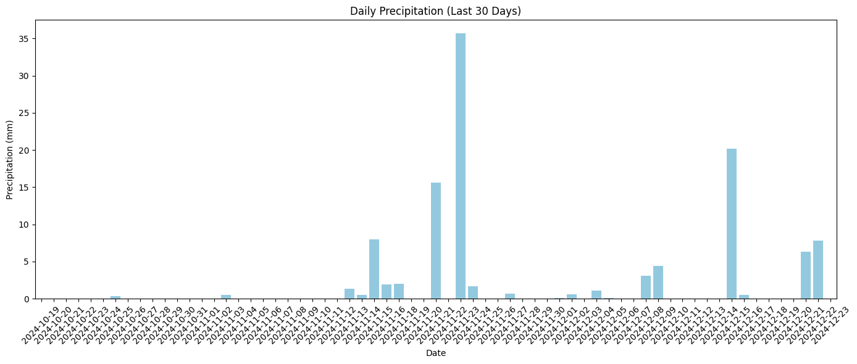
Here is the precipitation data in Sabancı University for last 3 months. According to the graph, approximately 20 days were rainy.

Slide 7
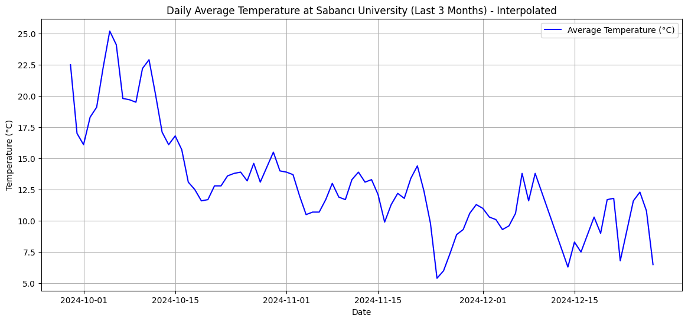
The graph shows the temperature in Sabanci University day by day.

Slide 8
Then, I began combining both datasets and evaluating the validity of my hypothesis.

Slide 9
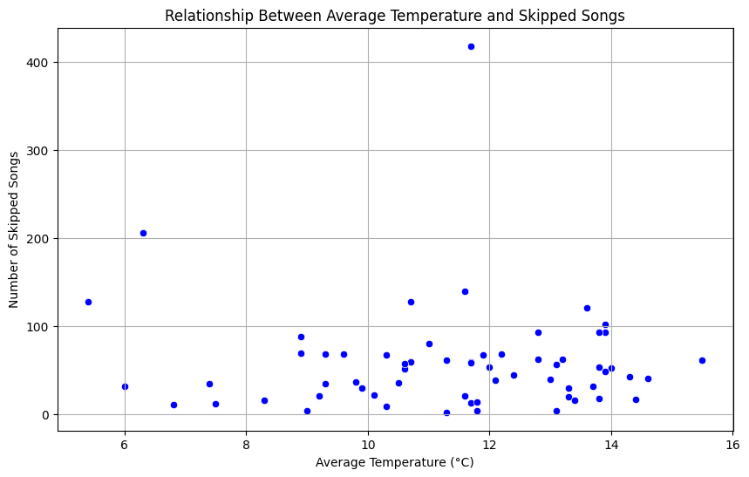
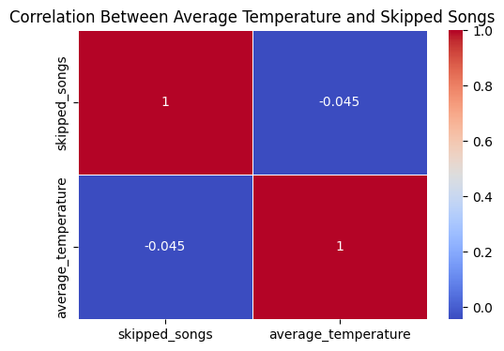
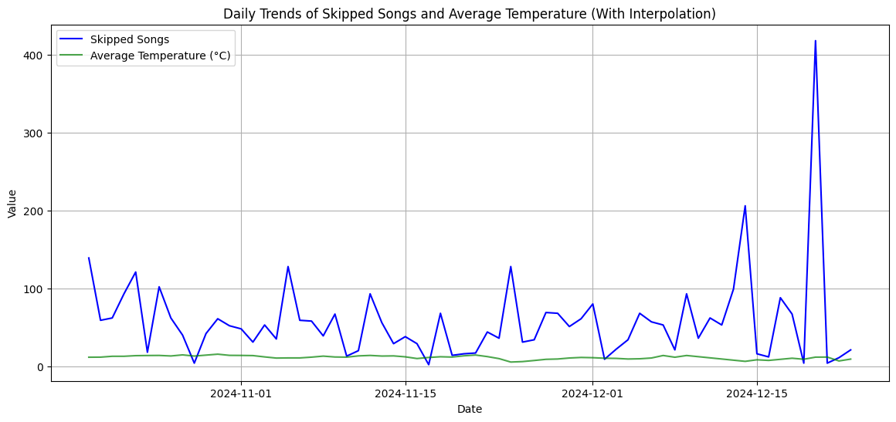
As shown in the graphs, there is no correlation between the average temperature and number of skipped songs

Slide 10
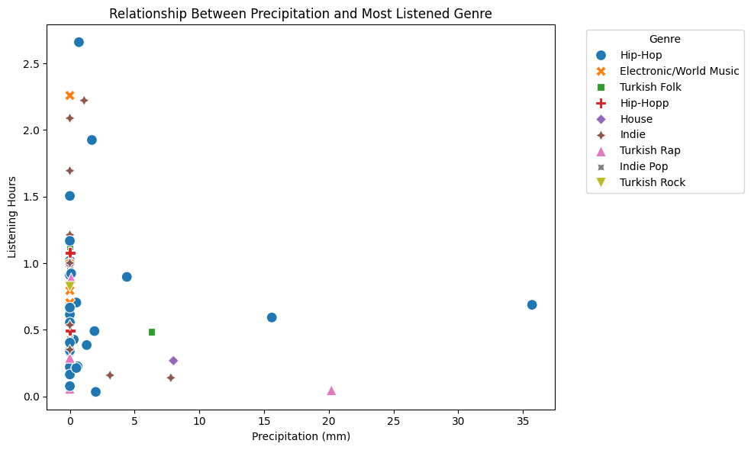
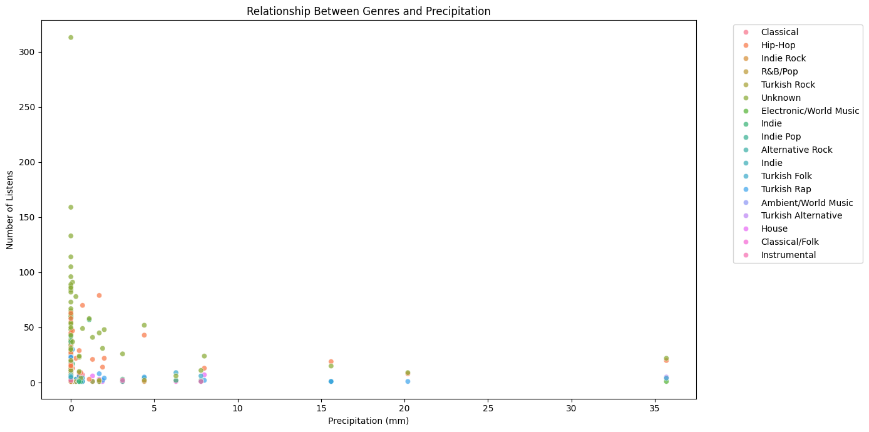
As seen in the graphs there is no correlation between which genre I listen and the weather is rainy or not

Slide 11
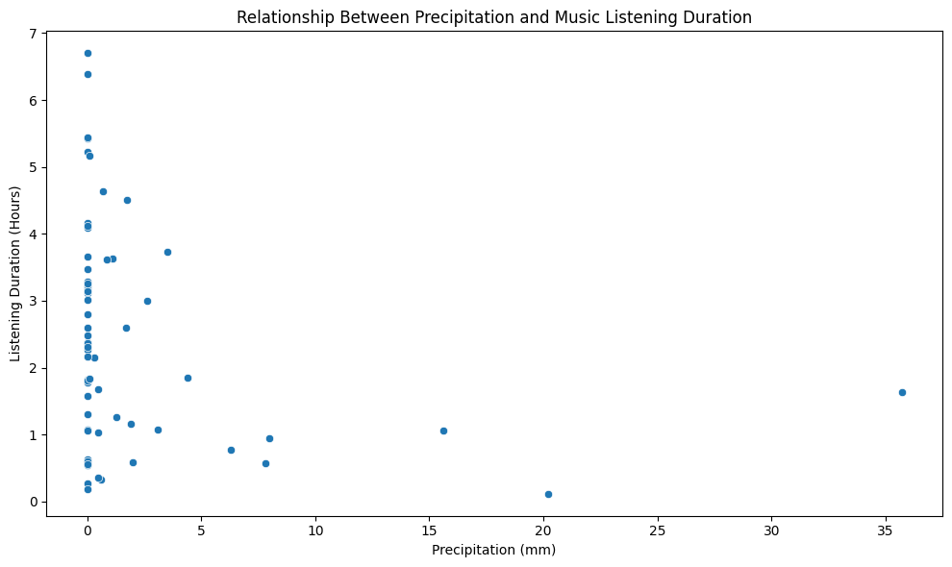
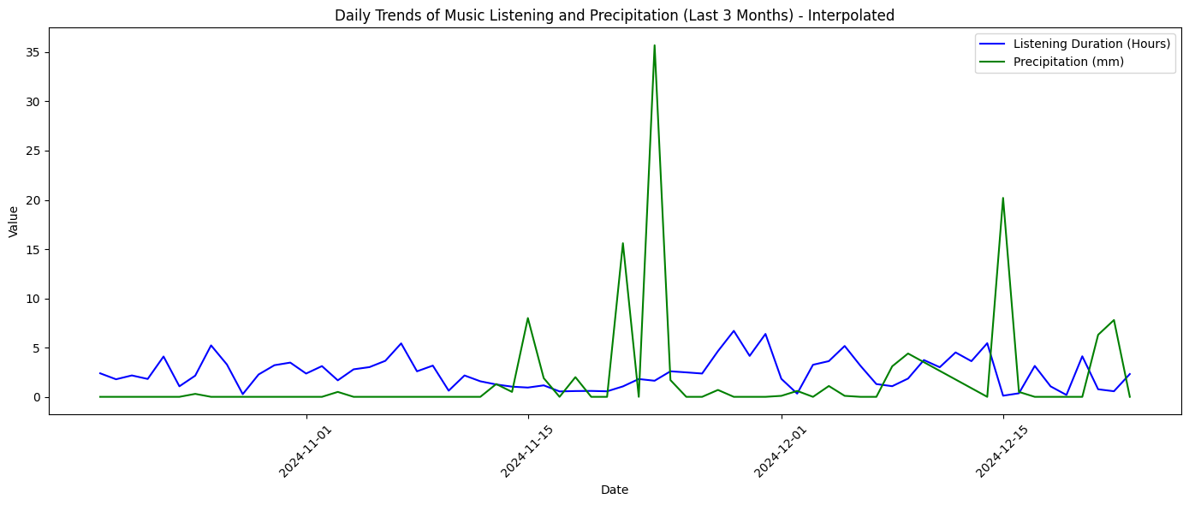
Lastly, I analyzed the relationship between music listening duration and precipitation, but no correlation was found.

Slide 12
Thank you for viewing!

